Slide 1
COMPX304-23A
Advanced Networking and Cybersecurity
Week 10
Symmetric key Distribution + Hardware Vulnerabilities
Vimal Kumar
Slides: Vimal Kumar, Chris Anderson, Panos Patros

Slide 2
Symmetric Key Encryption
Provides confidentiality
Is faster compared to alternatives
Is suitable for fast hardware implementation
But ….
  How do we exchange secret keys

Slide 3
Symmetric Key Distribution
A can select a key and physically deliver it to B.
A third party can select the key and physically deliver it to A and B.
  Usually called a Key Distribution Center
If A and B have previously and recently used a key, one party can transmit the new key to the other, encrypted using the old key.
If A and B each has an encrypted connection to a third party C, C can deliver a key on the encrypted links to A and B.

Slide 4
Needham-Schroeder Protocol
Third-party key distribution protocol
For session between A B mediated by KDC protocol overview is:
  1. A→KDC: ID_{A} || ID_{B} || N₁
  2. KDC→A: E_{Ka}[Ks || ID_{B} || N₁ || E_{Kb}[Ks||ID_{A}] ]
  3. A→B: E_{Kb}[Ks||ID_{A}]
Notes:
This is the original, basic key exchange protocol. Used by 2 parties who both trusted a common key server, it gives one party the info needed to establish a session key with the other. Note that since the key server chooses the session key, it is capable of reading/forging any messages between A&B, which is why they need to trust it absolutely!
Note that all communications is between A&KDC and A&B, B&KDC don't talk directly (though indirectly a message passes from KDC via A to B, encrypted in B's key so that A is unable to read or alter it). Other variations of key distribution protocols can involve direct communications between B&KDC.

Slide 5
Needham-Schroeder Protocol
used to securely distribute a new session key for communications between A & B
but is vulnerable to a replay attack if an old session key has been compromised
  then message 3 can be resent convincing B that is communicating with A
modifications to address this require:
  timestamps
  using an extra nonce
Notes:
There is a critical flaw in the protocol, as shown. This emphasises the need to be extremely careful in codifying assumptions, and tracking the timeliness of the flow of info in protocols. Designing secure protocols is not easy, and should not be done lightly. Great care and analysis is needed.

Slide 6
Key Distribution Solutions
Key distribution solutions based on symmetric key requires a KDC
They also require the communicating parties to trust the KDC.
There are key distribution solutions that use asymmetric cryptography that don’t require KDCs and trust in KDCs but require public key infrastructure (PKI)
The alternative (although expensive) is key exchange based on a quantum phenomenon
Algorithms based on quantum computing can help perform key exchange without the use of KDCs and PKI.

Slide 7
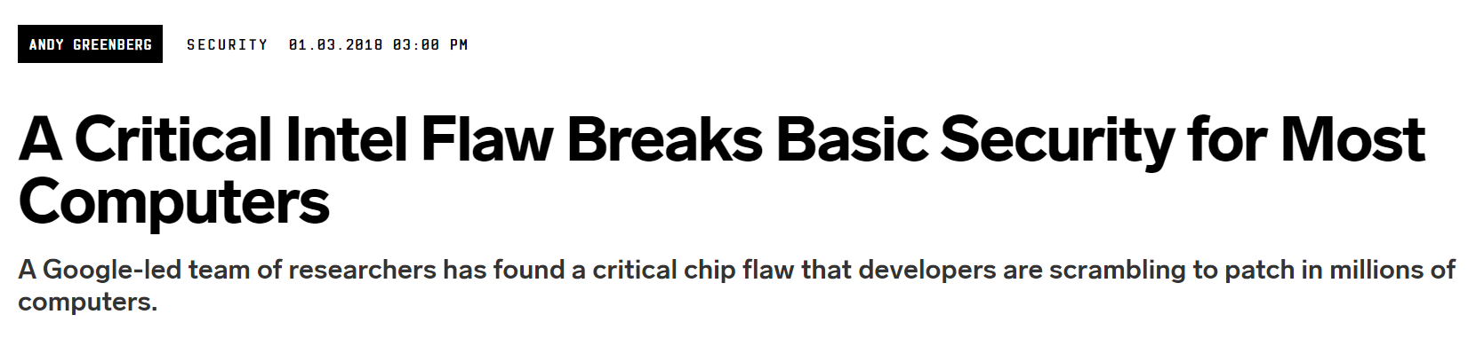
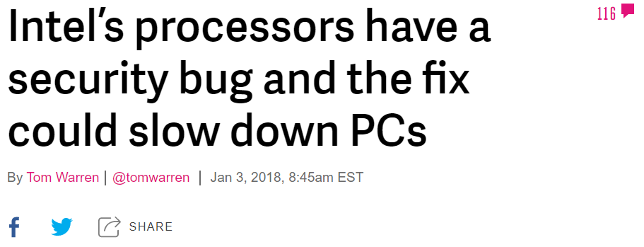
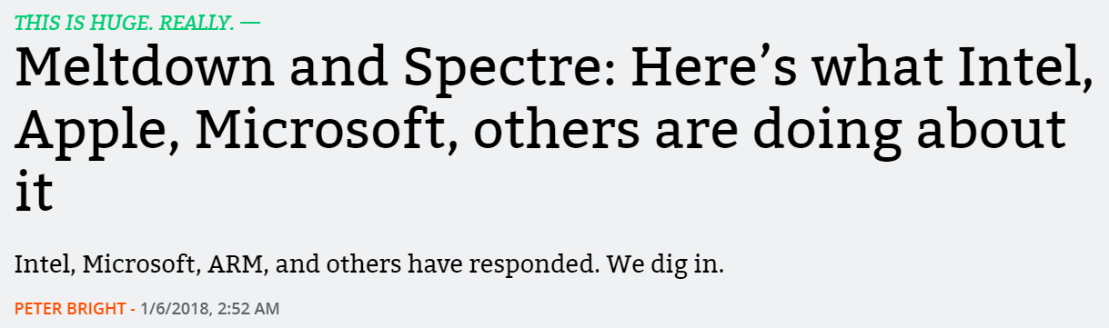


Meltdown and Spectre
https://www.wired.com/story/critical-intel-flaw-breaks-basic-security-for-most-computers/
https://www.theverge.com/2018/1/3/16844630/intel-processor-security-flaw-bug-kernel-windows-linux
https://arstechnica.com/gadgets/2018/01/meltdown-and-spectre-heres-what-intel-apple-microsoft-others-are-doing-about-it/

Slide 8
Meltdown and Spectre
Confidentiality attacks
Extracts private information
  Bit by bit
Spectre
  Breaks isolation
Meltdown
  Breaks isolation between user applications and the OS.

Slide 9
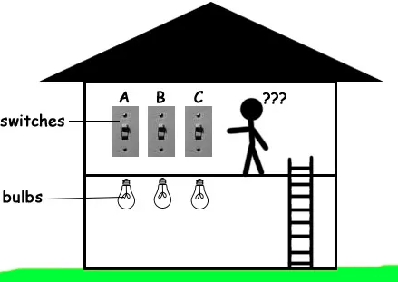

Slide 11
For a technical understanding
we need to know about:
  Computer Architecture
  Computer Organization

Slide 12
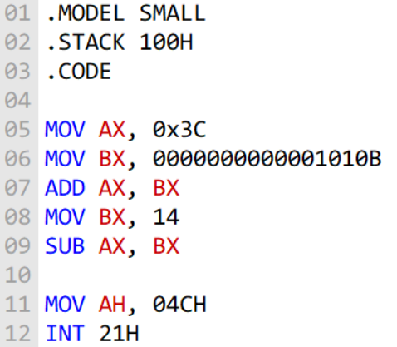
Computer Architecture
The interface the CPU implements
Also known as Instruction Set Architecture (ISA)
  Load, store, add, etc.
Programs execute in it. The CPU always repeats:
  Fetch the next instruction
  Decode it
  Execute it

Slide 13
Computer Organization
The mechanics under the ISA
Transparent to the user
But physical/real
Not just a spec
Programs
Invoke
Computer Architecture
ISA Specification
Implements
Computer Organization
Operate
Computer Hardware
Notes:
Computer Org refers to everything under the ISA. Like an good interface, it’s completely transparent to the user.
When you write code for x86, all x86 devices should be able to execute it. X86 is a bit more of a complicated instruction set as there are extensions to it and not all CPUs support all of them.
That includes right up to today where only Intel support AVX-512.
But by and large, you write x86 code and it will run on AMD and Intel CPUs – those are the two big vendors for x86 – fine. But both vendors implement the ISA differently.
Ultimately, this can lead to individual instruction performance varying between vendors. This is an problem compilers solve for us.

Slide 14
CPU Cache
Main memory is much slower than the CPU
We do not want the CPU to be idle for long periods of time
Cache is a smaller but faster piece of memory closer to the CPU
Every time something is fetched from the main memory it is also stored in the cache
80:20 rule

Slide 15
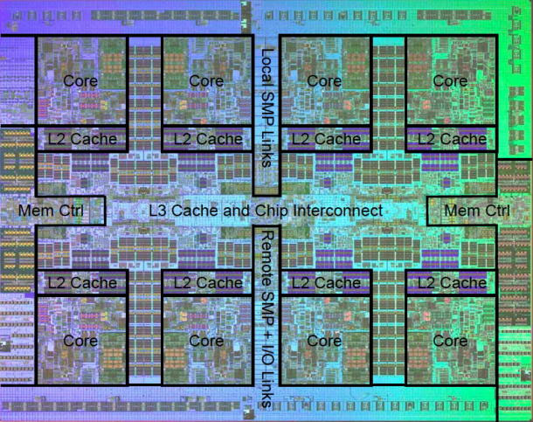
CPU Cache
A load 0x… is not just a load!
  The address is converted to its physical address and permissions are checked
  The address is looked up in the Level-1 (L1) cache. If not there,
  It’s looked up in the L2 cache. If not there,
  In the L3 cache, if not there
  From main memory (cache miss)
Each of these pathways take a significantly different time (CPU cycles) to complete
https://arstechnica.com/gadgets/2009/09/ibms-8-core-power7-twice-the-muscle-half-the-transistors/

